Slide 1
Approach from Scratch to Solution
Objective:
A personalized fitness plan generator with a user-friendly GUI.
Personalization: Tailor fitness plans to individual user needs and goals.
User-Friendly GUI: Ensure the interface is intuitive and easy to navigate for users of all levels of technical proficiency.

Slide 2
Approach from Scratch to Solution
Requirements:
1. Gather User Information:
Name: User’s name for personalized communication.
Age: Age to tailor the plan appropriately for different age groups.
Weight: Weight in kilograms for BMI calculation and fitness recommendations.
Height: Height in centimeters for BMI calculation.
Fitness Goal: Specific goals like weight loss, muscle building, or flexibility improvement.
Days per Week: Number of days the user intends to work out per week.
Preferred Workout Duration: Duration preference (short, medium, long).

Slide 3
Approach from Scratch to Solution
2.Generate a Fitness Plan:
Plan details:
Goal-based Exercises: Choose exercises aligned with the user’s goal.
Daily Workouts: Plan exercises for each day based on user’s weekly commitment.
Duration: Ensure each workout fits within the user’s preferred duration.
3.Display the Plan:
Display elements:
Day-wise Breakdown: Show exercises for each day with clear labeling.
Exercise Details: Include exercise type, name, and duration.
Overall Summary: Summarize the plan for the user to understand the overall structure.

Slide 4
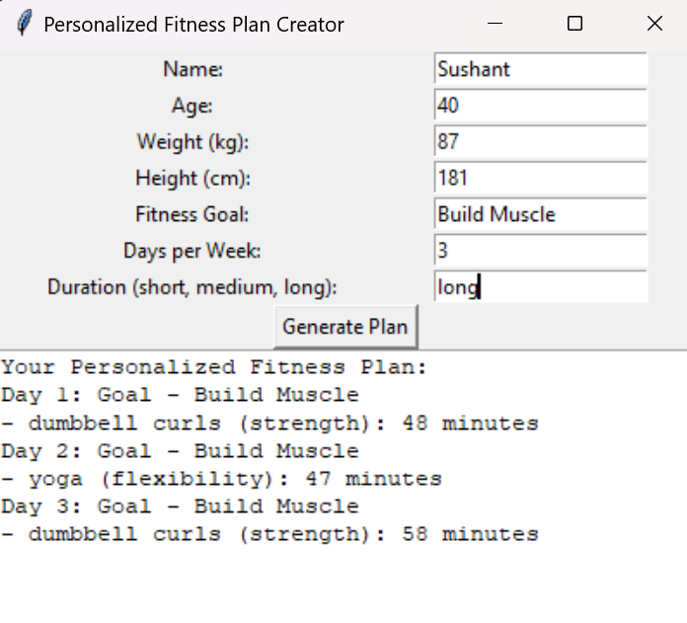
Approach from Scratch to Solution

Slide 5
Approach from Scratch to Solution
Plan the Architecture and Design
a. Architectural Components:
Input Handling: Module to gather and validate user inputs, ensuring accuracy and completeness.
Plan Generation Logic: Module to generate the personalized fitness plan based on the user’s input.
GUI: Module to create an interactive and visually appealing interface for user interaction.
b. Technology Stack:
Python: Chosen for its simplicity and extensive libraries that support both GUI development and backend logic.
Tkinter : Python’s standard GUI library, suitable for creating simple, interactive desktop applications.
c. Design the Data Flow:
User inputs data -> Data is validated -> Fitness plan is generated -> Plan is displayed to the user.

Slide 6
Approach from Scratch to Solution
Develop the Core Logic:
fitness_plan.py
Explanation
Imports: The random module is imported to facilitate the random selection of exercises and durations.
Class FitnessPlanCreator: This class contains methods to generate a fitness plan.
Constructor __init__: Initializes the exercise categories and duration options.
Method generate_fitness_plan: Generates a plan for each day based on user inputs.
Method generate_daily_plan: Generates a plan for a single day, choosing exercises and durations randomly within the specified constraints.

Slide 7
Approach from Scratch to Solution
gui.py
Explanation
Imports:
tkinter is imported for GUI components.
messagebox is imported for showing error messages.
FitnessPlanCreator is imported from fitness_plan.py.
Class FitnessPlanGUI: This class creates the GUI and handles user interactions.
Constructor __init__: Initializes the GUI components (labels, entry widgets, button, and text widget).
Method gather_user_info: Collects and validates user inputs from the entry widgets.
Method generate_plan: Calls the FitnessPlanCreator to generate a plan and displays it.
Method display_fitness_plan: Displays the generated fitness plan in the text widget.
Function main: Creates the main window and starts the GUI event loop.

Slide 8
Approach from Scratch to Solution
main.py
Explanation
Import: The main function from gui.py is imported.
Entry Point: The script checks if it is being run as the main module, and if so, it executes the main function to start the GUI application.
Develop the GUI
Designing the GUI Layout:
Using Tkinter , create forms and display areas . I ensured the interface is intuitive, with clear labels and input fields.

Slide 9
Approach from Scratch to Solution
Analysis of the Technique Used
Chosen Technique: Rule-Based System with Randomization
Reasoning:
1.Simplicity:
- A rule-based system is straightforward to implement and understand. It involves defining a set of rules based on user inputs and applying these rules to generate a fitness plan.
- Randomization adds variability to the fitness plans, making each plan unique and engaging without requiring complex logic.
2.Customizability:
- Easily customizable based on user input, allowing for adjustments and expansions as needed. For example, new exercises or goals can be added to the system without significant changes to the overall structure.
- Simple to extend with new exercises or additional logic, making it scalable and adaptable to future requirements.

Slide 10
Approach from Scratch to Solution
3.Efficiency:
- Quick generation of fitness plans without the need for extensive computation or data processing.
- Suitable for real-time applications where immediate feedback is essential, enhancing user experience.
4.Practicality:
- Ideal for applications where detailed user-specific data might not be available or where machine learning models would be an overkill.
- Can be implemented by developers with basic knowledge of programming and without the need for advanced machine learning expertise.

Slide 11
Approach from Scratch to Solution
Alternative Techniques:
1.Machine Learning:
-Pros : Could be used for more sophisticated personalization based on historical data and user preferences. Machine learning models could potentially predict the best exercises and routines for a user based on large datasets of similar users.
-Cons : Requires a large dataset and extensive training, making it complex and resource-intensive. The lack of sufficient data can lead to poor model performance. Additionally, the interpretability of the model might be lower compared to rule-based systems.

Slide 12
Approach from Scratch to Solution
2.Genetic Algorithms:
-Pros : Can optimize fitness plans by simulating evolution processes to find the best combination of exercises. This method can generate highly personalized plans tailored to the user’s specific needs and goals.
-Cons : Computationally intensive and may require significant processing power and time to generate optimal plans. The complexity of implementing genetic algorithms may also be a barrier for developers without specific expertise in this area.
3.Expert Systems:
-Pros : Leverage knowledge from fitness experts to create highly accurate and effective fitness plans. These systems can mimic the decision-making ability of a human expert.

Slide 13
Approach from Scratch to Solution
-Cons : Building an expert system requires extensive knowledge engineering, which involves extracting and coding the knowledge from human experts. This process is time-consuming and requires collaboration with fitness professionals.
Conclusion
The rule-based system with randomization offers a balanced approach, combining simplicity, efficiency, and customizability. It provides a practical solution for generating personalized fitness plans while ensuring that the system remains adaptable and easy to maintain.

